Slide 1


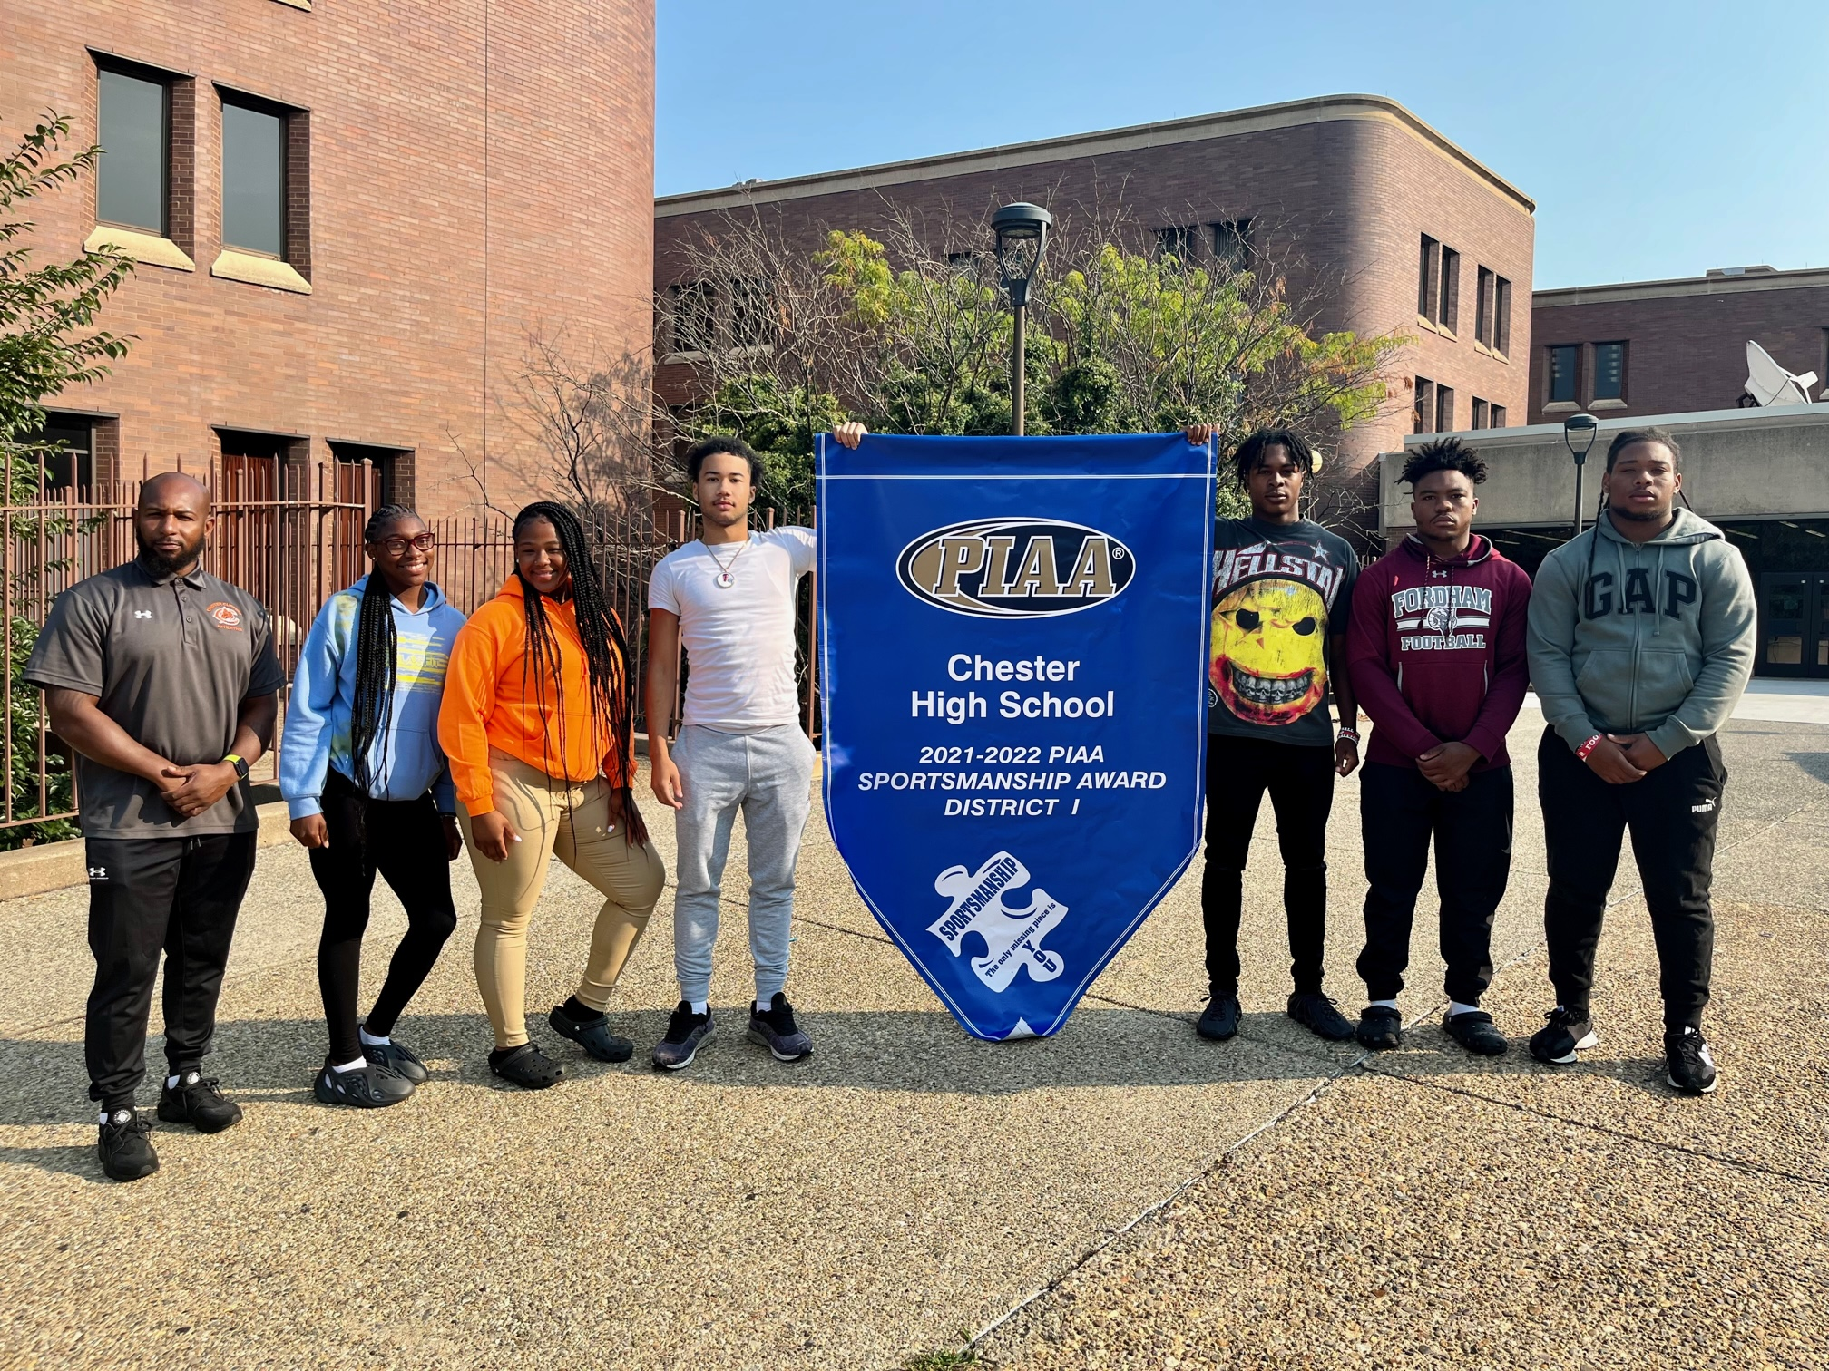
CHESTER UPLAND SCHOOL DISTRICT
2023-2024 Budget Presentation
DeJuana Mosley
Business Administrator
May 25th 2023
Equity and Excellence for All
1

Slide 2

Presentation Agenda:
Review of 2023 fiscal priorities
Progress of 2023 fiscal priorities
2023 fiscal changes
Proposed 2024 millage rates
Proposed 2024 revenues
Strategy creating the 2024 budget
2024 fiscal priorities
  Pros & cons
Proposed 2024 expenditures

Slide 3





District’s 2022-2023 Fiscal Priorities:
Create a budget that reflects realistic and conservative revenues while capturing all CUSD’s debt obligations and expenditures
The
Real Deal
Controlled cost – contracts, compliance and internal controls
Managed Expectations
Prioritizing expenditures based on cash flow and cost-effective measures
Strategic Planning
Develop transparent and quality partnerships with existing and new vendors
Culture
Enhance revenue sources through municipal and local business support
Teamwork makes the dream work

Slide 4

Progression of the 2023 fiscal priorities:
1. Creating a realistic budget:
Accurate planning
Support to lobby for additional funding
4. Transparency with vendors:
Established trust
Created cooperation
Vendors that would never…
2. Compliance and internal controls:
Reduction in negative fund balance
One audit down, two to go
Audit ready
5. Enhance revenue sources:
New revenue sources
Strategically time receivables
3. Prioritize based on cash flow:
No advance for fiscal 2023
Improved timeliness of disbursements

Slide 5
2023 Fiscal Changes: Effective July 1st 2022
Revenue projections
  New revenue sources
  Lowered actual revenues
Unexpected expenditures
  Fringe benefits
  The IRS
Enrollment
  Decrease in CUSD’s enrollment
  Increase in Charter’s (including two new charter schools)
New facilities
  Edgmont Scholars Academy (formerly WPCS)
  Administration Building (1350 Edgmont Avenue)
New debt
  2022 General Obligation Bond
New contracts
  Act 93 (administrative)
  PSEA (teachers)
  ESPSEA (non-instructional staff)
  Teamsters (Maintenance)

Slide 6

PROPOSED MILLAGE RATES:
CHESTER CITY – 14.31 MILLS
(Reduction of 5.98%)
CHESTER TOWNSHIP – 14.25 MILLS (Reduction of 7.23%)
BOROUGH OF UPLAND – 14.25 MILLS (Reduction of 7.23%)
How your tax bill is determined:
Multiply your assessment value by the millage
(move the decimal three times to the left)
Chester City example: $50,000 X .01431 = $715.50
Chester Twp/Upland example: $150,000 x .01425 = $2,137.50

Slide 7
Proposed 2023-2024 Revenues:
Projected Revenues:
Local – $23,113,110
State – $119,876,312
Federal – $17,989,929
Other - $7,250,000
Projected Revenues: $168,229,351

Slide 8
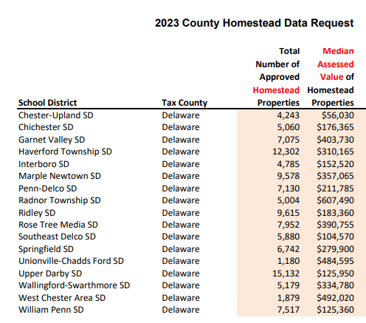
What changed: Local Level
Decrease of 4.26%
Countywide reassessment in 2021
Tax exemption of CUSD
Correction of Homestead
Realistic current real estate tax estimate
Strategic delinquent tax collection
Municipality with CUSD | Exempted Assessment | Dollar Value (using proposed millage rates)
Chester Township | $66,793,926 | $885,019.52
Upland Borough | $45,078,922 | $597,295.72
Chester City | $525,104,432 | $7,162,424.45
Total | $636,977,280 | $8,644,739.69

Slide 9
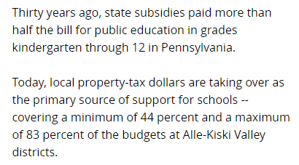
What changed: State Level
Level up funding incorporated
  Basic education subsidy
  Special education subsidy
State property tax relief consistent
Accurate budgeting of other subsidies

Slide 10
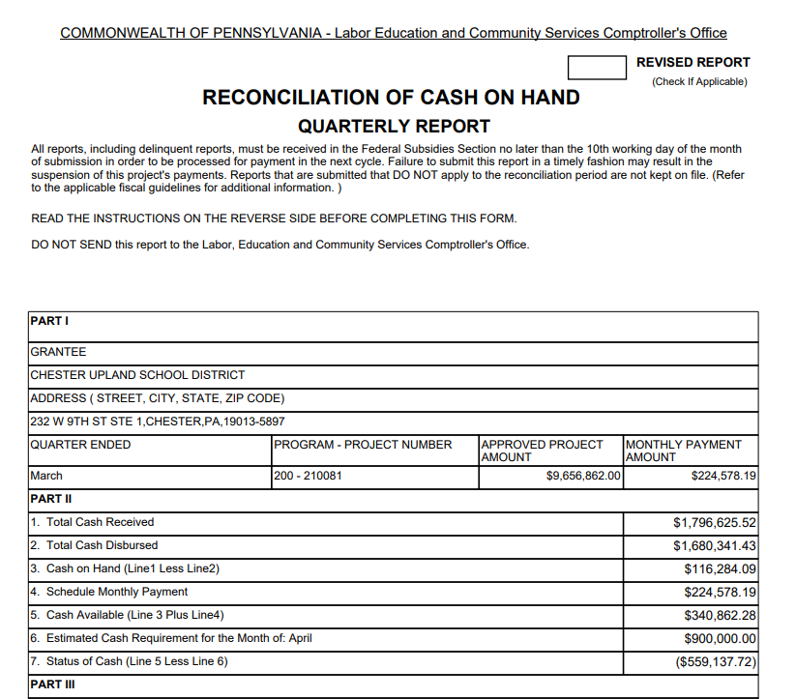

What Changed: Federal Level
Federal compliance
Accurate quarterly reporting
Significant carryover consolidated funds
ESSER funds heavily incorporated

Slide 11
Revenue Comparison:

Slide 12

2024 Expenditure Strategies:
Goal:
  Exit Receivership
Strategy:
  Establish baseline
Plan:
  Assertive budget
    Mandated obligations
    Prioritize largest expenditures
    Capture REAL and added cost

Slide 13

2024 Top Fiscal Obligations: Pros & Cons
Charter Tuition:
  Receivership requirement
  Impacts cash flow
  Servicing students
5. Transportation
Legal requirement
Increase attendance
Safety
2. Personnel:
Quality staff
Retention
Morale
4. Special Education:
Significant population
Additional funding
Lowers liability
3. Debt Service:
Redirected payments
Impacts credit rating
Ability to borrow

Slide 14
Proposed 2023-2024 Expenditures:
Projected Expenditures:
Charter Payments – $58,000,000
Personnel – $50,098,010
Capital Projects - $14,460,756
Debt Service - $12,363,236
Special Education - $12,525,700
Transportation - $5,243,600
Past Due Obligations - $4,000,000
Other Expenditures - $18,918,876
Projected Expenditures: $175,610,178

Slide 15
Expenditure Comparison:

Slide 16
Proposed 2023-2024 Overview:
Revenue Source | 2022-2023 Budget | Difference | 2023-2024 Budget
Local Revenues | $ 26,760,052.00 | -14% | $ 23,113,110.00
State Revenues | $ 105,914,445.00 | 13% | $ 119,876,312.00
Federal Revenues | $ 15,212,305.00 | 18% | $ 17,989,929.00
Other Revenues | $ - |  | $ 7,250,000.00
TOTAL: | $ 147,886,802.00 | 14% | $ 168,229,351.00

Slide 17
Proposed 2023-2024 Overview:
Expenditures | 2022-2023 Budget | Difference | 2022-2023 Budget
Salaries | $ 27,675,300.00 | 14% | $ 31,642,267.18
Benefits | $ 18,407,674.00 | 10% | $ 20,255,444.77
Professional Services | $ 10,738,621.00 | 22% | $ 13,073,718.16
Property Services | $ 1,005,390.00 | 1492% | $ 16,010,756.00
Other Purchased Services | $ 63,688,930.00 | 12% | $ 71,104,969.28
Supplies | $ 2,941,352.00 | 76% | $ 5,184,537.70
Capitalized Equipment | $ 10,266,500.00 | -84% | $ 1,628,533.00
Other Objects | $ 1,043,225.00 | -67% | $ 346,715.00
Debt Services | $ 12,119,810.00 | 2% | $ 12,363,236.00
Past Due Obligations |  |  | $ 4,000,000.00
TOTAL: | $ 147,886,802.00 | 19% | $ 175,610,177.09
Projected Surplus/Deficit: - ($7,380,826)

Slide 18
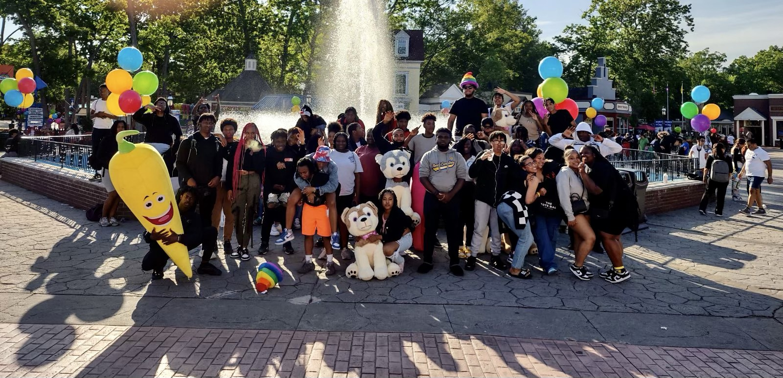
THANK YOU!

